Slide 1
22-3 UNICAST ROUTING PROTOCOLS
A routing table can be either static or dynamic. A static table is one with manual entries. A dynamic table is one that is updated automatically when there is a change somewhere in the Internet. A routing protocol is a combination of rules and procedures that lets routers in the Internet inform each other of changes.
Topics discussed in this section:
Optimization Intra- and Interdomain Routing
Distance Vector Routing and RIP
Link State Routing and OSPF
Path Vector Routing and BGP

Slide 2
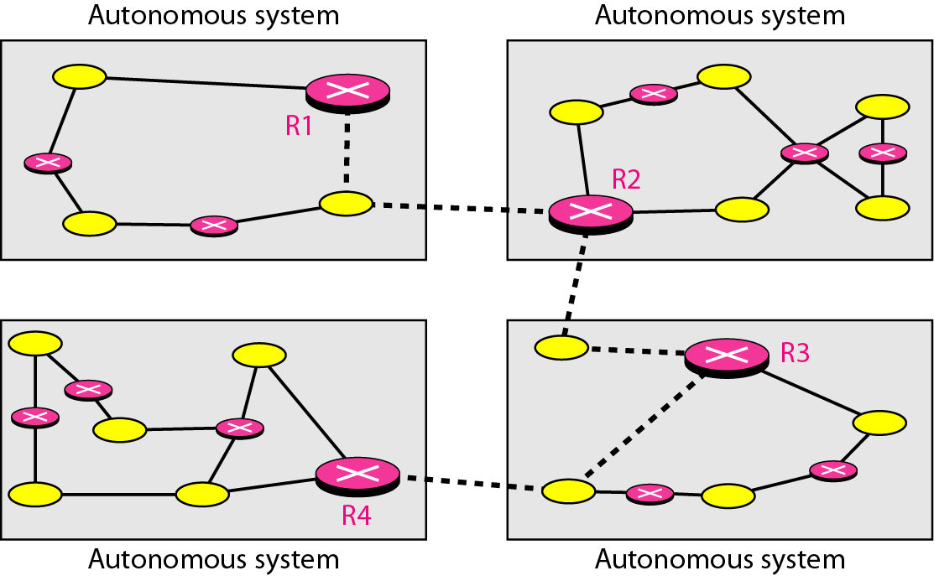
Figure 22.12 Autonomous systems

Slide 3
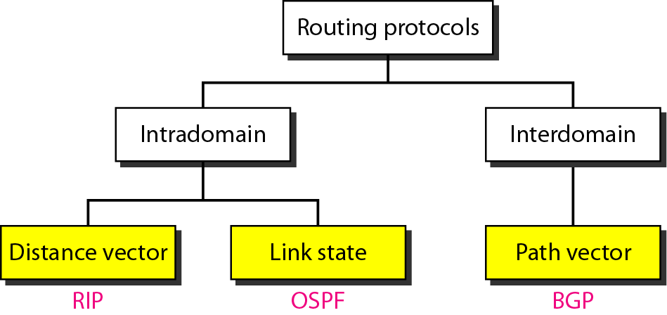
Figure 22.13 Popular routing protocols

Slide 4
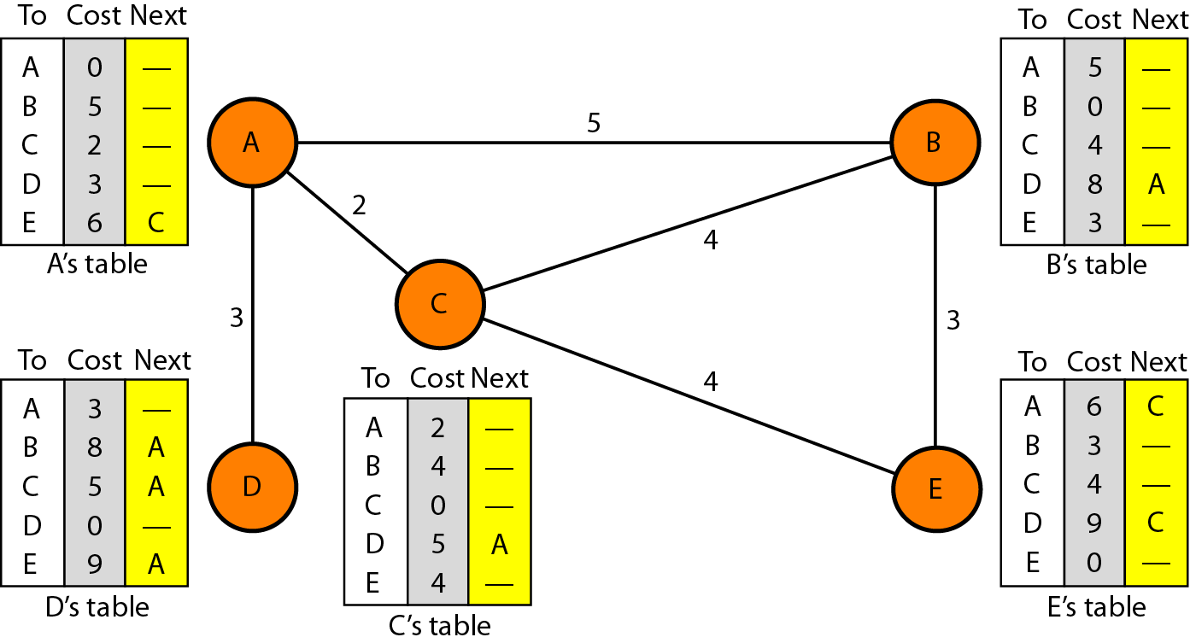
Figure 22.14 Distance vector routing tables

Slide 5
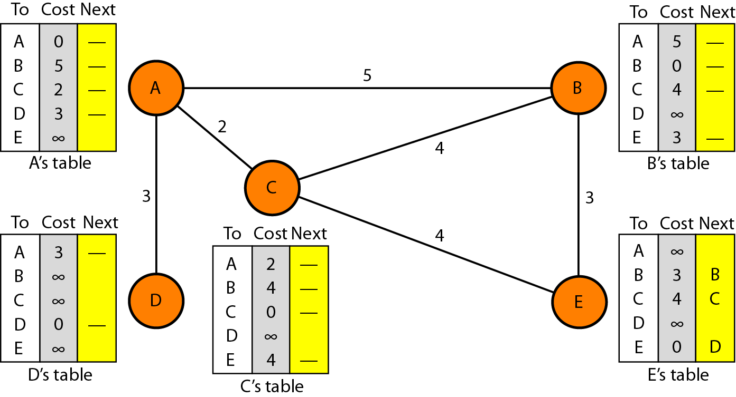
Figure 22.15 Initialization of tables in distance vector routing

Slide 6

Note
In distance vector routing, each node shares its routing table with its
immediate neighbors periodically and when there is a change.

Slide 7
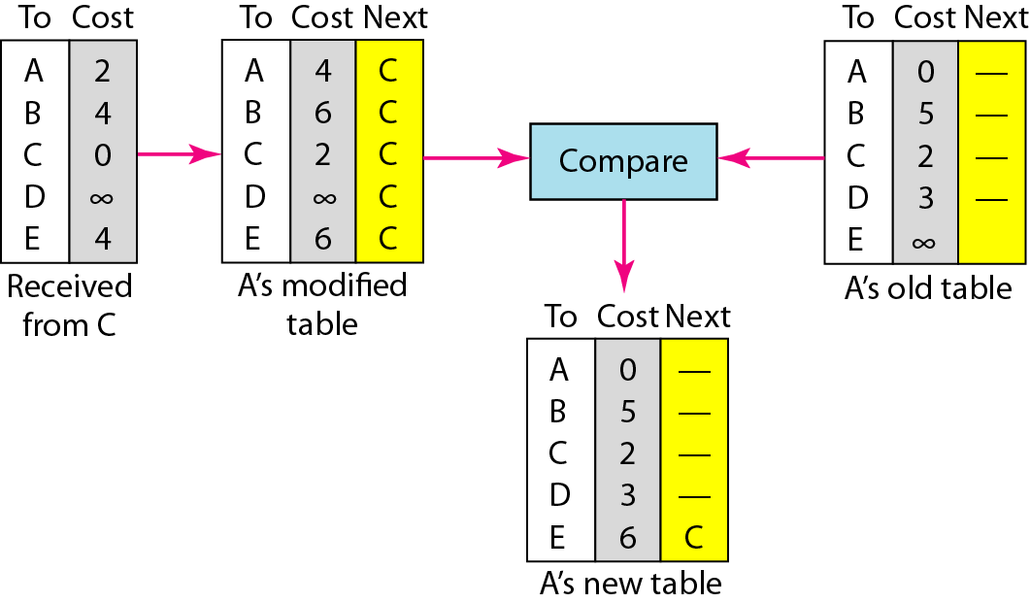
Figure 22.16 Updating in distance vector routing

Slide 8
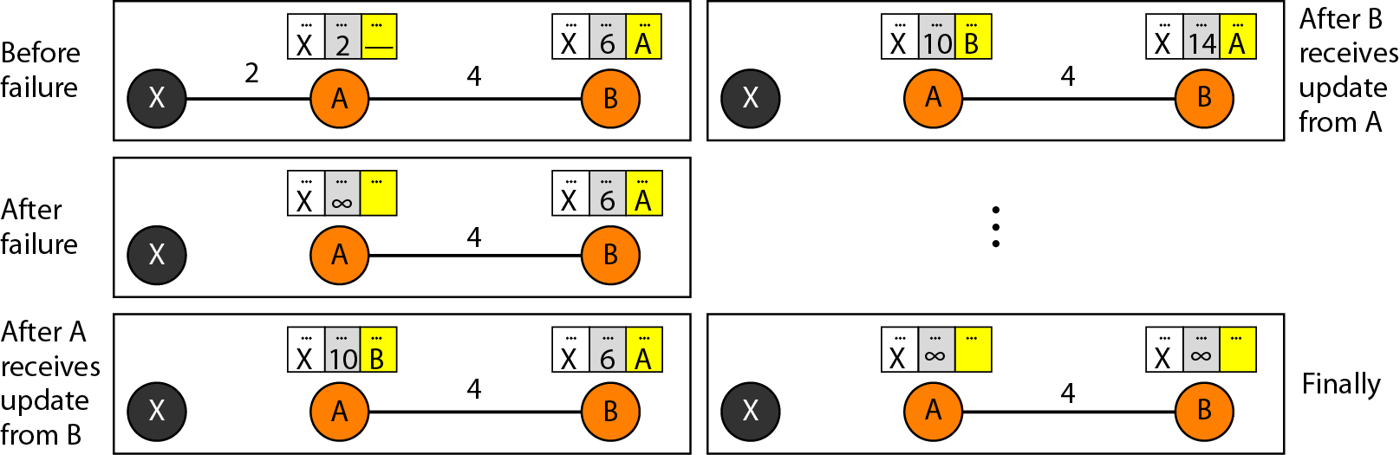
Figure 22.17 Two-node instability

Slide 9
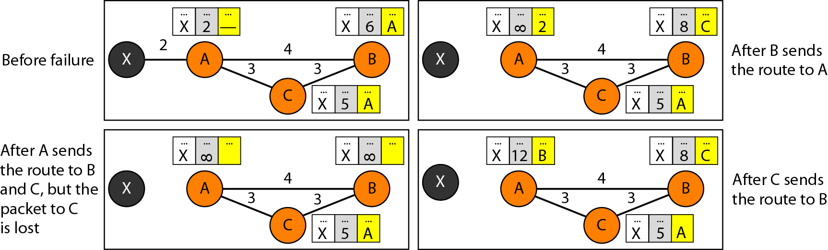
Figure 22.18 Three-node instability

Slide 10
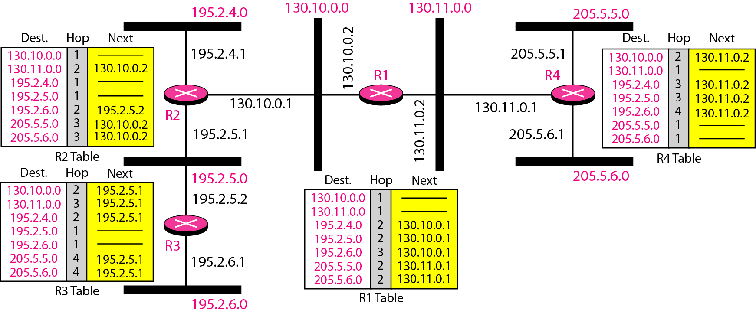
Figure 22.19 Example of a domain using RIP

Slide 11
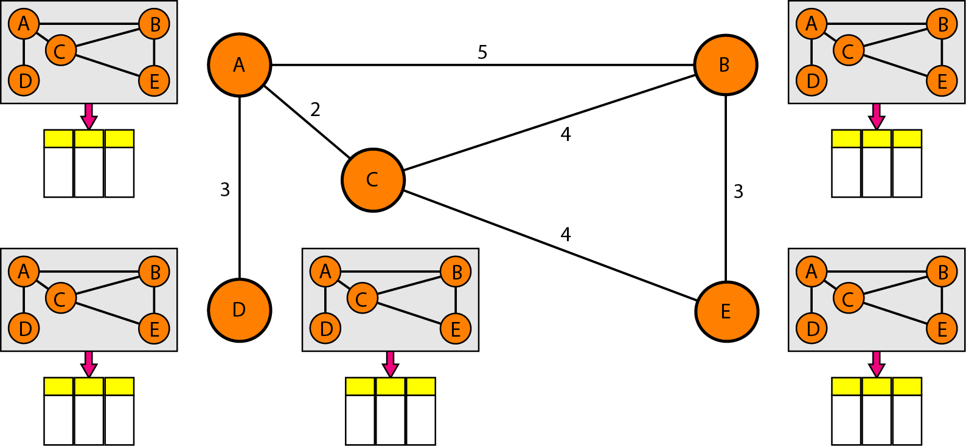
Figure 22.20 Concept of link state routing

Slide 12
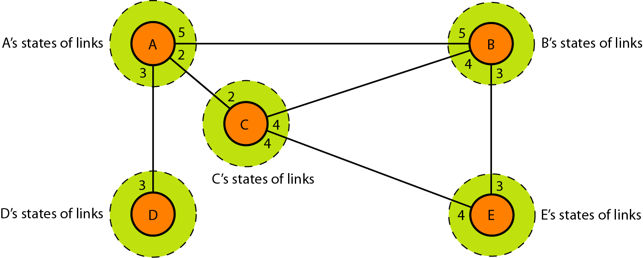
Figure 22.21 Link state knowledge

Slide 13
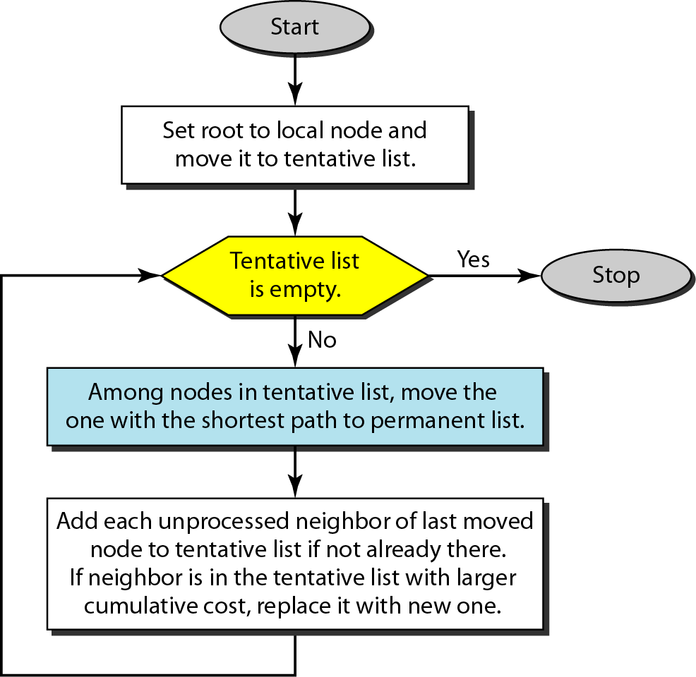
Figure 22.22 Dijkstra algorithm

Slide 14
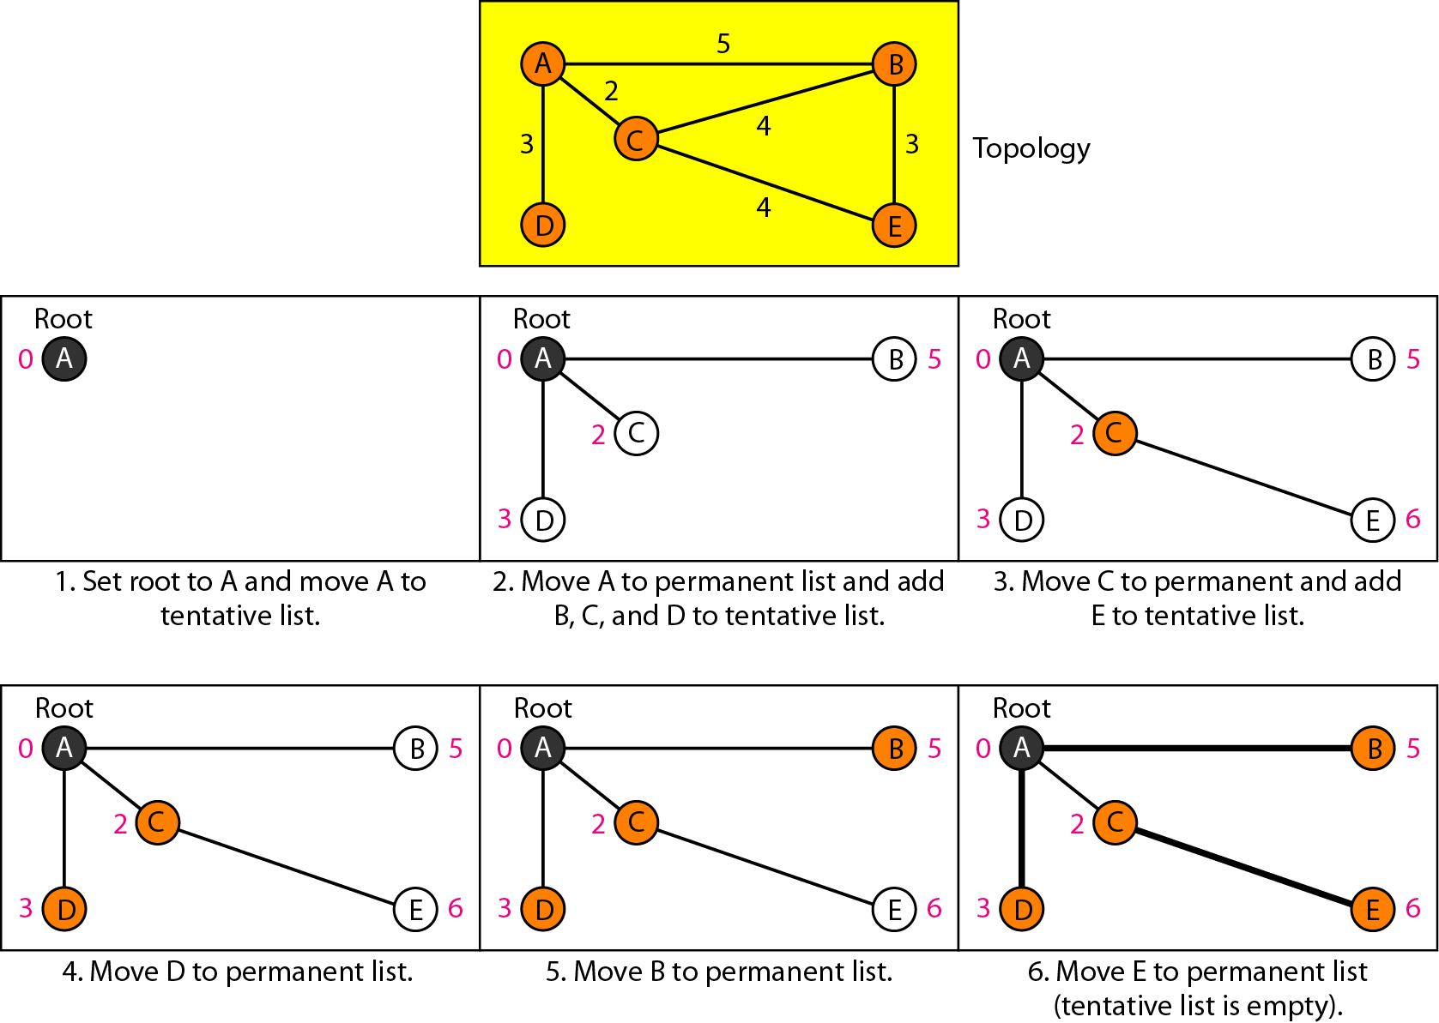
Figure 22.23 Example of formation of shortest path tree

Slide 15
Table 22.2 Routing table for node A

Slide 16
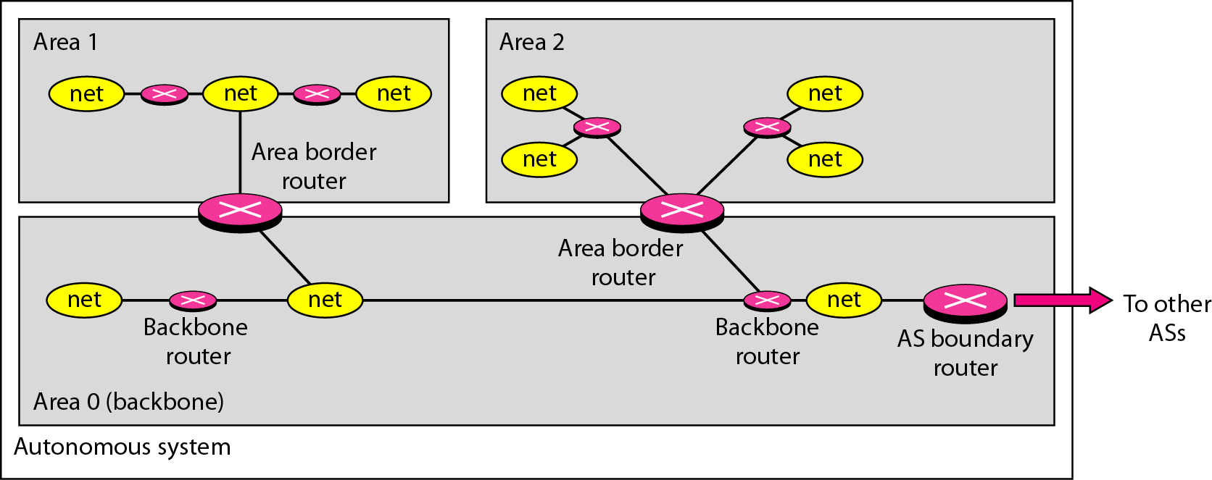
Figure 22.24 Areas in an autonomous system

Slide 17
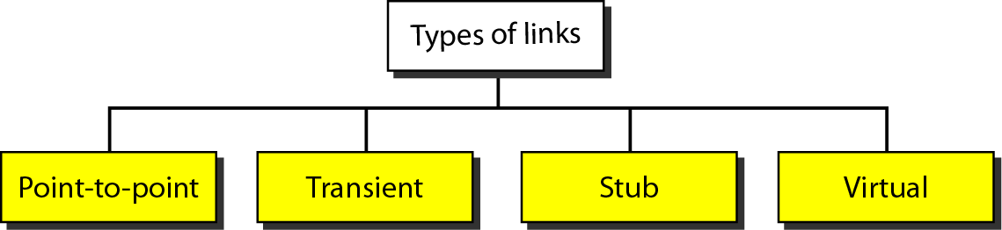
Figure 22.25 Types of links

Slide 18
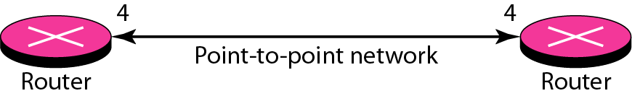
Figure 22.26 Point-to-point link

Slide 19
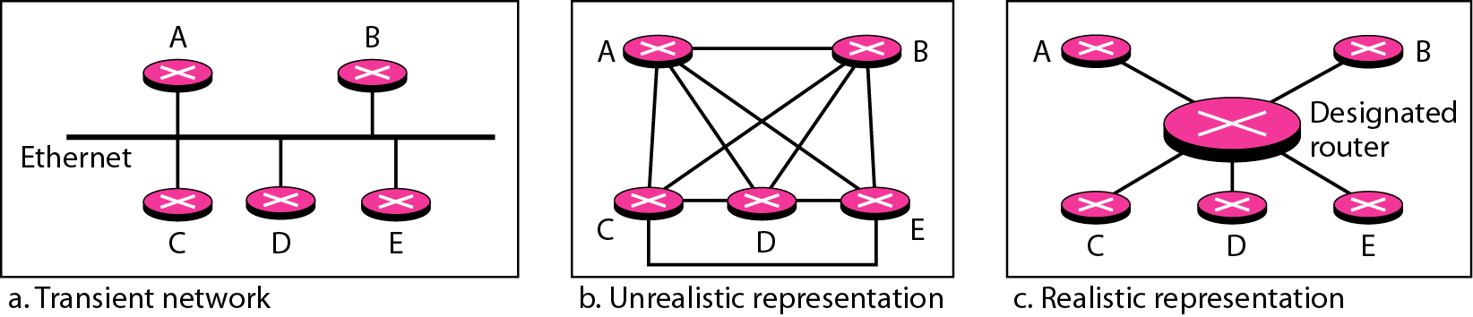
Figure 22.27 Transient link

Slide 20
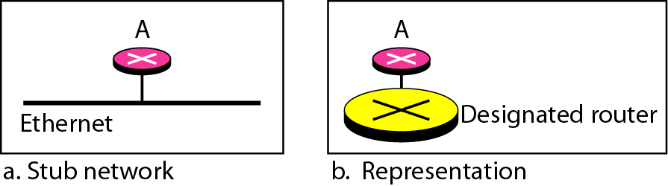
Figure 22.28 Stub link

Slide 21
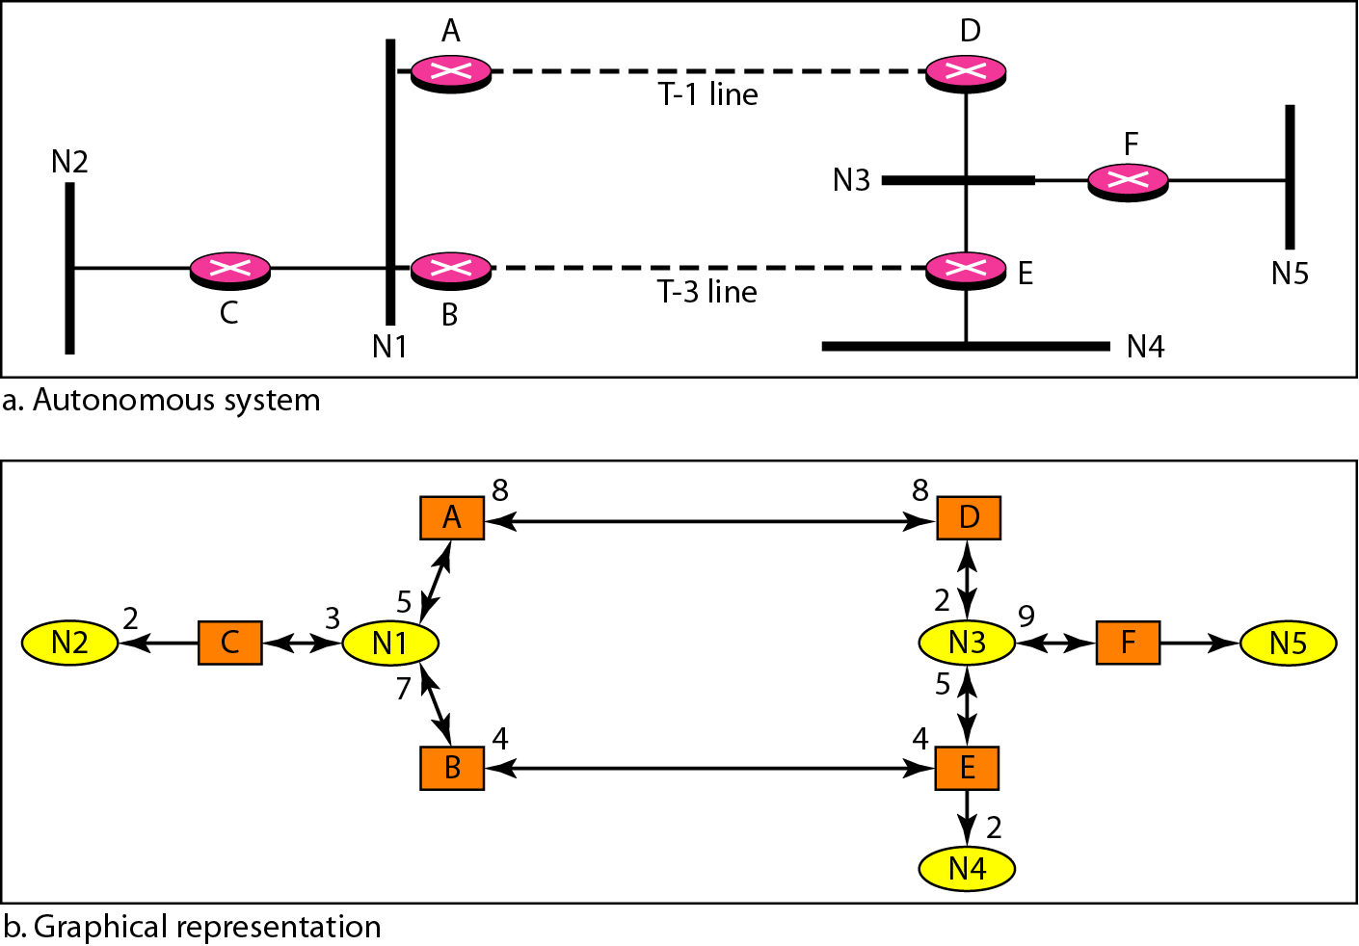
Figure 22.29 Example of an AS and its graphical representation in OSPF

Slide 22
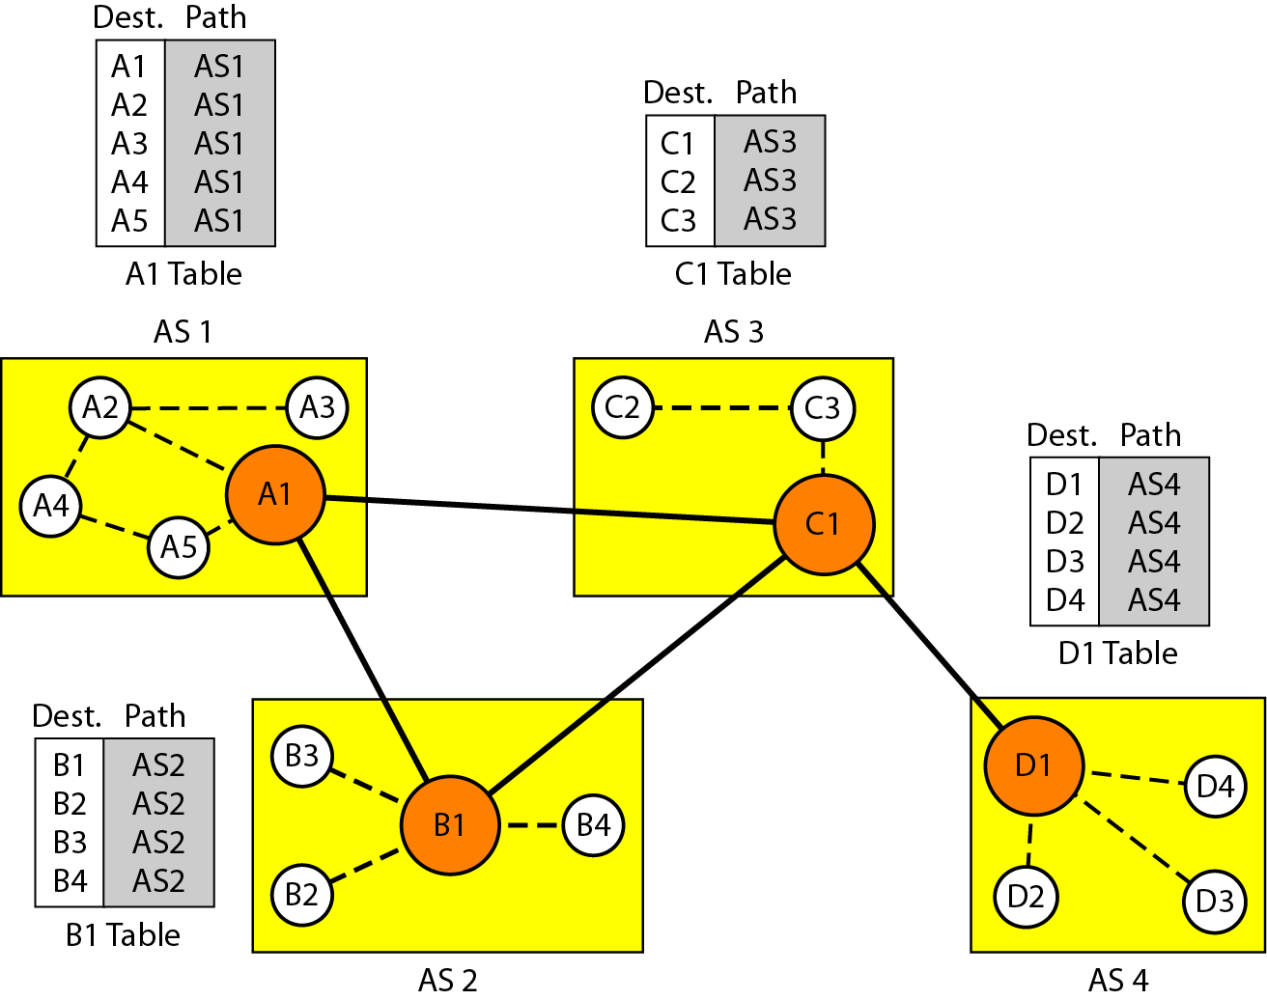
Figure 22.30 Initial routing tables in path vector routing

Slide 23
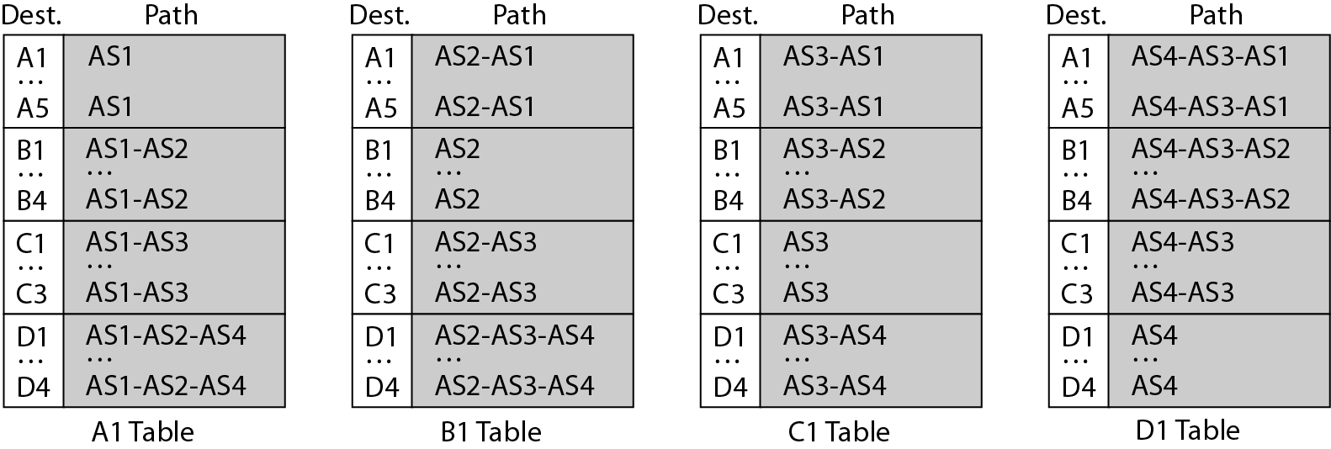
Figure 22.31 Stabilized tables for three autonomous systems

